Slide 1
“The ethical considerations that may arise in harnessing information for HIV prevention”
Harnessing information for HIV prevention
Tuesday 24 July, 11:00 – 12:30
Gail E. Henderson, PhD
University of North Carolina at Chapel Hill, USA
Department of Social Medicine, UNC School of Medicine

Slide 2
Ethics and HIV phylogenetics: A new field of inquiry
M. Kumi Smith, “Ethical Pitfalls of Network-Informed Approaches to HIV Prevention” IAS Tuesday 12:30-2:30,Hall 1, Abstract number: TUPED565
Coltart EM, Hoppe A, Parker M, et al. in press, “Ethical Considerations in Global HIV Phylogenetic Research.” Lancet HIV. IAS Abstract # TUPED557
Evans D, Benbow N (2018), “Ethical Considerations for a Public Health Response Using Molecular HIV Surveillance Data: A Multi-Stakeholder Approach.” Project Inform and Northwestern University. February. DOI 10.18131/G3MT7B
Mutenherwa F, Wassenaar DR, de Oliveira T (2018), “Ethical issues associated with HIV phylogenetics in HIV transmission dynamics research: A review of the literature using the Emanuel Framework.” Developing World Bioethics 1-11.

Slide 3
Basic challenges in HIV phylogenetic research and public health prevention applications
It is fundamentally relational: analyses may identify others as sources of infection
True anonymization of viral sequence data becomes difficult with advances in sequencing technology
  Thus, raises possibility of re-identification (using virus identified from another time-point in another study)
Notes:
In other words, sequencing raises issues of individual/patient identifiability and the reconstruction of transmission networks (from Pangea document)

Slide 4
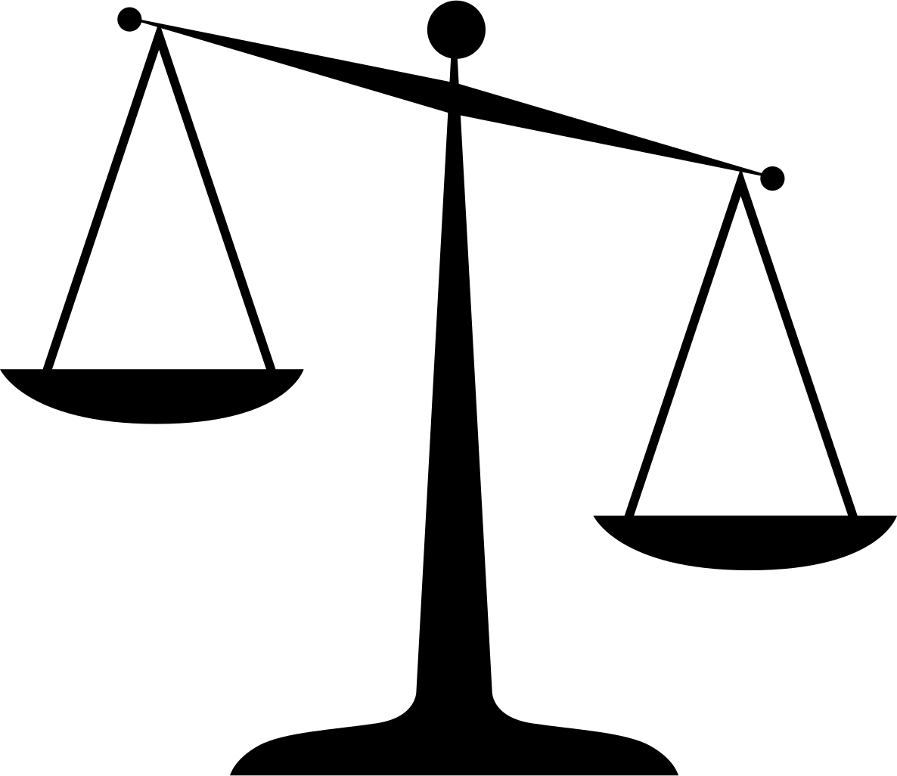
Key aspects of good ethical practice
Balancing individual risks and public health benefits
Notes:
Assessing risk and benefits, balancing protection of the rights and interests of study participants while pursuing scientific advance and improvements to public health.
Identifying strategies to protect risks to individual and group identities that may be created by phylogenetic research
Understanding local social and legal contexts where the research takes place, including human rights violations
Safeguards through focus on valid informed consent, enhancing community engagement and modes of communication (of complex science and risk probabilities)
Focus on equitable data sharing

Slide 5
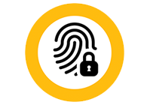
Key aspects of good ethical practice
Balancing individual risks and public health benefits
Protecting individual/group identities
Notes:
Assessing risk and benefits, balancing protection of the rights and interests of study participants while pursuing scientific advance and improvements to public health.
Identifying strategies to protect risks to individual and group identities that may be created by phylogenetic research
Understanding local social and legal contexts where the research takes place, including human rights violations
Safeguards through focus on valid informed consent, enhancing community engagement and modes of communication (of complex science and risk probabilities)
Focus on equitable data sharing

Slide 6
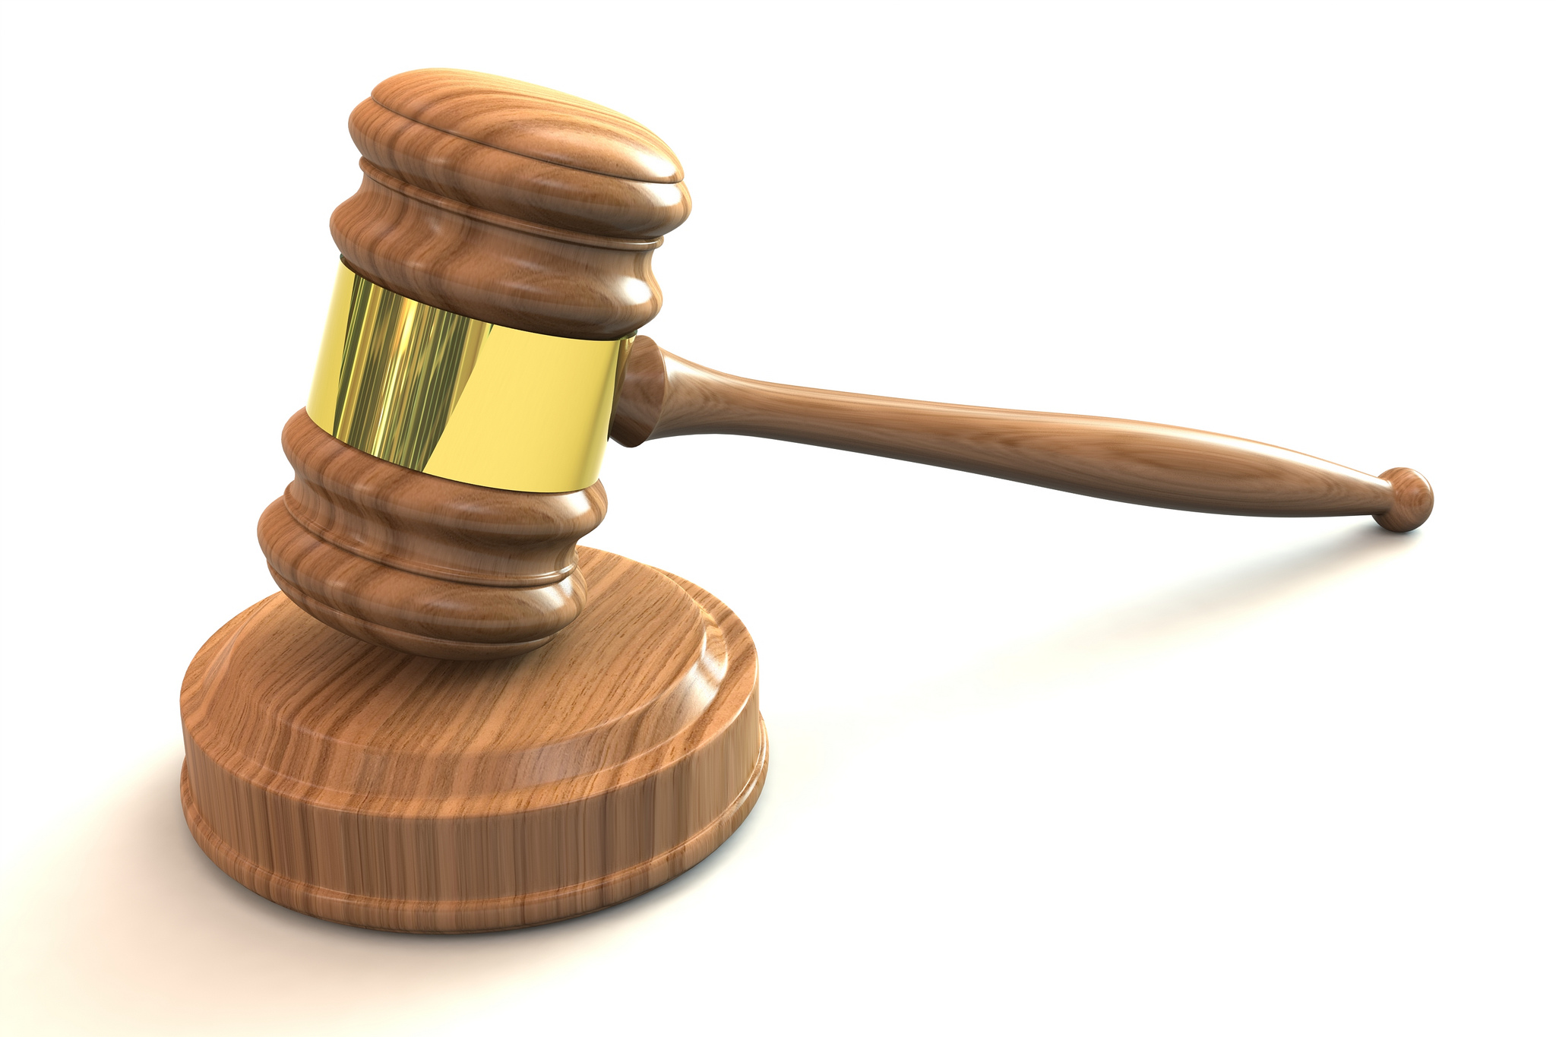
Key aspects of good ethical practice
Balancing individual risks and public health benefits
Protecting individual/group identities
Social and legal contexts
Notes:
Assessing risk and benefits, balancing protection of the rights and interests of study participants while pursuing scientific advance and improvements to public health.
Identifying strategies to protect risks to individual and group identities that may be created by phylogenetic research
Understanding local social and legal contexts where the research takes place, including human rights violations
Safeguards through focus on valid informed consent, enhancing community engagement and modes of communication (of complex science and risk probabilities)
Focus on equitable data sharing

Slide 7
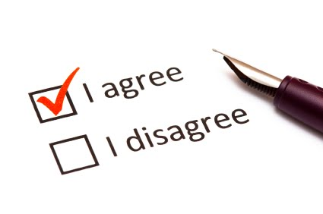
Key aspects of good ethical practice
Balancing individual risks and public health benefits
Protecting individual/group identities
Social and legal contexts
Safeguards: informed consent,
community engagement
Notes:
Assessing risk and benefits, balancing protection of the rights and interests of study participants while pursuing scientific advance and improvements to public health.
Identifying strategies to protect risks to individual and group identities that may be created by phylogenetic research
Understanding local social and legal contexts where the research takes place, including human rights violations
Safeguards through focus on valid informed consent, enhancing community engagement and modes of communication (of complex science and risk probabilities)
Focus on equitable data sharing

Slide 8

Key aspects of good ethical practice
Balancing individual risks and public health benefits
Protecting individual/group identities
Social and legal contexts
Safeguards: informed consent,
community engagement
5. Equitable data sharing
Notes:
Assessing risk and benefits, balancing protection of the rights and interests of study participants while pursuing scientific advance and improvements to public health.
Identifying strategies to protect risks to individual and group identities that may be created by phylogenetic research
Understanding local social and legal contexts where the research takes place, including human rights violations
Safeguards through focus on valid informed consent, enhancing community engagement and modes of communication (of complex science and risk probabilities)
Focus on equitable data sharing

Slide 9
Ethically, is there anything new when we sort PLWHA by phylogenetic means?
Exposing individuals to the risk of stigma or legal jeopardy, protecting confidentiality, employing community consent… all not new
Identifying individuals and communities through phylogenetic transmission networks?
  This raises key questions about how and when consent should occur, and pros and cons of informing individuals vs. communities

Slide 10
Ethical issues in human genetics
(“Ethical, Legal, and Social Implications Program” ELSI of NHGRI)
What is the meaning of genetic information?
Will genetic risk information be understood? What should be returned?
How is the information relevant to family or other group members?
Who controls the information? What happens if it is shared?
Do interests of individuals, families, communities, employers, insurers, and the state conflict?
Will diagnoses have reproductive or eugenic implications?

Slide 11
Translation to genetics of the virus?
Many similar issues…
But identifying the genetics of one’s virus (not one’s personal genome), and deducing transmission behaviors on that basis, is novel
  and requires focused attention to the ethical, legal, and social implications

Slide 12


Any questions?

Slide 13

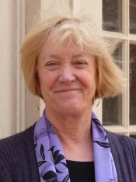
Contact Details
Gail E. Henderson, PhD
University of North Carolina School of Medicine
347A MacNider, 333 South Columbia Street
Chapel Hill, NC 27599-7240
Phone: 919-843-8268
gail_henderson@med.unc.edu

Slide 14
Key aspects of good ethical practice
assessing risks and benefits, balancing protection of the rights and interests of study participants while pursuing scientific advance and improvements to public health
identifying strategies to protect risks to individual and group identities that may be created by phylogenetic research
understanding local social and legal contexts where the research takes place, including human rights violations
safeguards through focus on valid informed consent, enhancing community engagement and modes of communication (of complex science and risk probabilities)
focus on equitable data sharing

Slide 15

Key aspects of good ethical practice
assessing risks and benefits, balancing protection of the rights and interests of study participants while pursuing scientific advance and improvements to public health
identifying strategies to protect risks to individual and group identities that may be created by phylogenetic research
understanding local social and legal contexts where the research takes place, including human rights violations
safeguards through focus on valid informed consent, enhancing community engagement and modes of communication (of complex science and risk probabilities)
focus on equitable data sharing

Slide 16
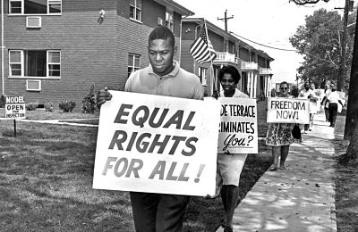
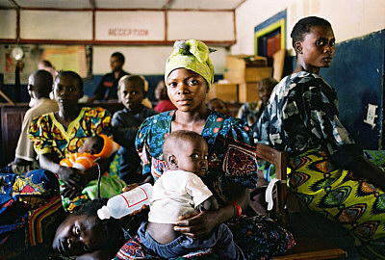
Key aspects of good ethical practice
assessing risks and benefits, balancing protection of the rights and interests of study participants while pursuing scientific advance and improvements to public health
identifying strategies to protect risks to individual and group identities that may be created by phylogenetic research
understanding local social and legal contexts where the research takes place, including human rights violations
safeguards through focus on valid informed consent, enhancing community engagement and modes of communication (of complex science and risk probabilities)
focus on equitable data sharing

Slide 17
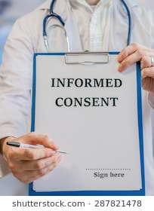
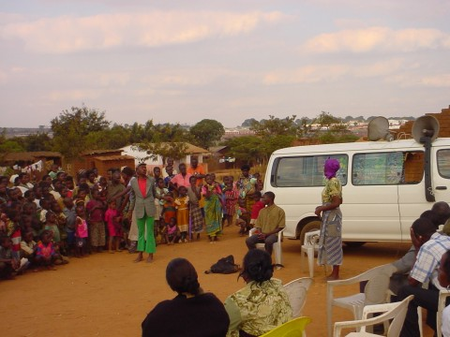
Key aspects of good ethical practice
assessing risks and benefits, balancing protection of the rights and interests of study participants while pursuing scientific advance and improvements to public health
identifying strategies to protect risks to individual and group identities that may be created by phylogenetic research
understanding local social and legal contexts where the research takes place, including human rights violations
safeguards through focus on valid informed consent, enhancing community engagement and modes of communication (of complex science and risk probabilities)
focus on equitable data sharing
Notes:
Drama troupe explaining a study in Malawi

Slide 18
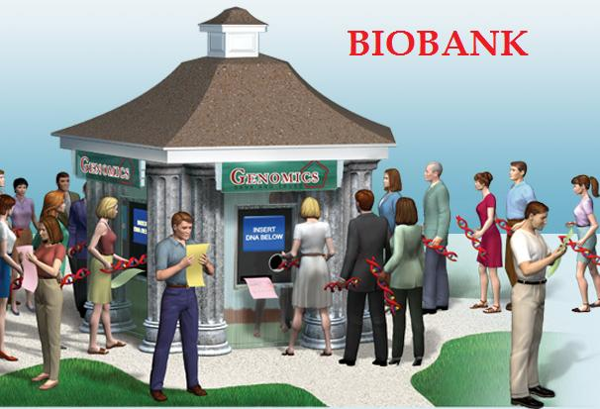
Key aspects of good ethical practice
assessing risks and benefits, balancing protection of the rights and interests of study participants while pursuing scientific advance and improvements to public health
identifying strategies to protect risks to individual and group identities that may be created by phylogenetic research
understanding local social and legal contexts where the research takes place, including human rights violations
safeguards through focus on valid informed consent, enhancing community engagement and modes of communication (of complex science and risk probabilities)
focus on equitable data sharing

